Slide 1
City of Chico
Presentation of Audit Reports
June 30, 2021
December 22, 2021

Slide 2
Agenda
Purpose of our Audit
Audit Approach
Summary of Audit Results by Engagement
Required Audit Communication to Governance
Recent Governmental Accounting Standards Board (GASB) Pronouncements

Slide 3
Purpose of Our Audit
Express opinions providing reasonable, but not absolute, assurance whether the City’s financial statements are free from material misstatement whether due to fraud or error

Slide 4
Audit Approach
Planning
Develop timeline
Preliminary risk assessment/ account analysis
Systems Evaluation
Understanding/ test internal controls
Design audit programs based on risk
Testing and Analysis
Field work
Execute audit plan
Reporting
Review of deliverables
Communication of findings/ recommendations
PBC listing
Finalize review of trial balance

Slide 5
Summary of Audit Results by Engagement
Engagement | Opinion on Financial Statements | Audit Findings
Annual Comprehensive Financial Report (ACFR) | Unmodified | None Reported
Chico Urban Area JPFA (DPCU) | Unmodified | None Reported
Passenger Facility Charges Report | Unmodified | 2 Significant Deficiencies

Slide 6
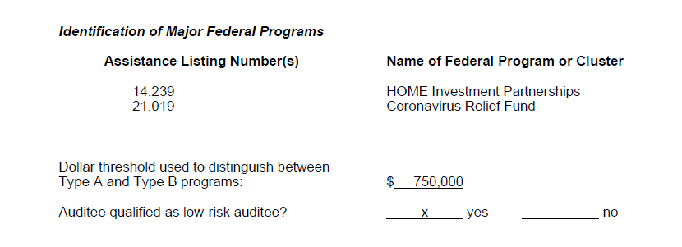
Summary of Audit Results by Engagement
Engagement | Opinion on Compliance over Major Federal Programs | Opinion on I/C over Major Federal Programs | Audit Findings
Single Audit | Unmodified | Unmodified | None Reported

Slide 7
Summary of Audit Results: Recap of Findings
Engagement | Type | Account | Condition | Recommendation
Passenger Facility Charges | SD | SOAR Reports | Quarterly SOAR reports not prepared and submitted timely | Continue to work with FAA to obtain accurate reports from SOAR reporting module.

Slide 8
Required Audit Communication
Matter to be Communicated | Auditors’ Response
Accounting Policies | Significant accounting policies are described in Note 1. No new accounting policies and no significant changes.
Accounting Estimates | Claims liability based on third party actuarial reports Net pension liability based on actuarial reports
Corrected Misstatements | No significant corrections identified
Disagreements with Management | No disagreements with management
Consultations with Other Accountants | No consultations with other accountants

Slide 9
Required Audit Communication (continued)
Matter to be Communicated | Auditors’ Response
Fraud and Illegal Acts | None identified
Significant Difficulties Encountered During the Audit | No significant difficulties were encountered while performing our audit procedures.
Other Information in Documents Containing Audited Financial Statements | Communicated responsibilities with respect to required supplementary information (RSI), supplementary information (combining fund statements, introductory section and statistical section) and the schedule of expenditures of federal awards (SEFA)
Management Representations | Management provided us with a signed copy of the management representation letter upon completion of each engagement

Slide 10
Recent Governmental Accounting Standards Board (GASB) Pronouncements
GASB Statement No. 87: Leases.
Effective for fiscal year 2021/22.

Slide 11
Questions?

