Slide 1

CITY OF CHICO
2020 CLIMATE ACTION PLAN
Overview of Plan Components

Slide 2
Chico Climate Action History
Chico City Council authorizes Mayor to sign US Conference of Mayor’s Climate Protection Agreement November 3, 2006
  315th City in the nation to sign the agreement. First Northstate City to sign
  Signature Cities commit to strive to meet Kyoto Protocol greenhouse gas reduction (7% GHG reduction from 1990 levels)
Sustainability Task Force formed March 2007
  Make recommendations on how to implement the Mayor’s Agreement
  Make recommendations on initiatives that will reduce greenhouse gas (GHG) emissions
  Advise Council on other Sustainability issues and items.

Slide 3
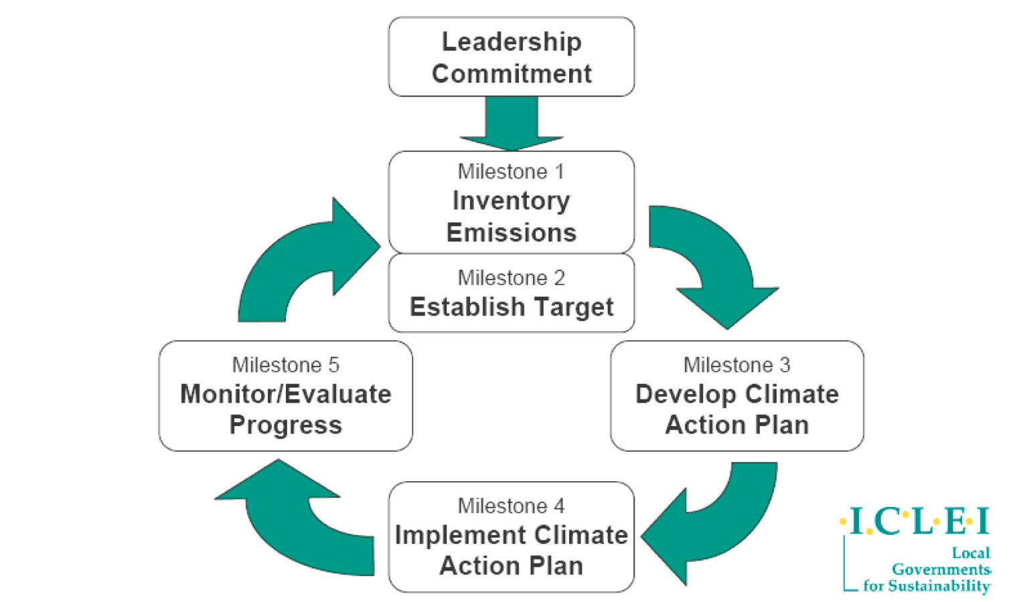
ICLEI Climate Action Milestones

Slide 4
STF Accomplishments
Conducted Baseline Greenhouse Gas (GHG) Inventory
  ICLEI software used to inventory GHG Emissions for City and Community. Established base year of 2005.
Set Target GHG Reductions
  City Council approves reducing emissions to 25% below 2005 levels by 2020.
Assisted in the preparation of the Sustainability Element of the City’s 2030 General Plan
Climate Action Plan
Notes:
4

Slide 5
2005 Emissions Inventory Results
Inventory Breakdown
by Sector
Total 2005 Emissions: 514,332 MteCO2

Slide 6
Emissions Inventory Baseline and Projections

Slide 7
Climate Action Plan Targets
Phase I Target: Reduce GHG emissions to 5% below 2005 levels by the end of 2015.
  = Total Reduction of 140,103 MtCO2e per year
Phase II Target: Further Reduce GHG emissions to 25% below 2005 base year levels by end of 2020.
  = Total Reduction of 169,653 MtCO2e per year
Total GHG Reductions: 309,756 MtCO2e

Slide 8
Sector Goals
The Goal is to Reduce Relative GHG Emissions from the Following Sectors:
  Transportation
  Energy & Water Conservation
  Solid Waste
  Community Outreach
    Sustainable Business Program
    Outreach and Education Committee
    PG&E Innovators Pilot Program
    Sustainability Website

Slide 9
Mitigation Actions
More than 80 potential GHG reduction measures identified by the Sustainability Task Force and City Staff.
  The majority promoted in the 2030 General Plan
Chose Actions based on:
  GHG reduction potential
  Costs
  Feasibility
  Other benefits associated with the measures (i.e. energy savings)

Slide 10
How GHG Reduction Actions Count
To count a GHG emission reduction action, the act must affect a change or reduction in an emissions-producing activity from the way it was emitting GHG in 2005, or change the manner in which it was projected to emit GHG in subsequent years (Business as Usual).

Slide 11
How Their Impact is Quantified
“Emissions Factors”
  What per unit impact, measured in MteCO2, an action will have on reducing aggregate emissions levels per year
  These factors are developed and reassessed by the EPA. They assume some generalizations based on national averages; but CAPPA also allows for customization using local conditions.

Slide 12
SOURCES FOR ESTIMATING GHG EMISSION REDUCTIONS
ICLEI’s Climate and Air Pollution Planning Assistant (CAPPA) software. Provides standard assumptions for the different measures and allows for local inputs.
Environmental Protection Agency (EPA)
Energy Emission Factors from PG&E
U.S. Department of Energy
CalTrans
Other GHG Reduction Protocols

Slide 13
For Example
Hybrid Cars
  Emissions Factor: 3.29 MteCO2/yr
  Unit Input: 1 Car
  CAPPA Assumptions:
    12,042 Average Annual Miles Per Vehicle
    46 MPG hybrid, 19.7 MPG avg for replaced vehicle
    Fuel consumption: 262 gallons vs. 611 gallons/yr
    0.0094127 MteCo2 emissions/gallon of gasoline
    (611 gals -262 gals)*0.0094127= 3.29 MteCO2 reduced/yr

Slide 14










Identified Emissions Reductions Between 2005-2015
Identified GHG reduction actions taken by the City and the community since the 2005 base year.
The impact of the existing local actions and potential new actions are estimated to reduce GHG emissions levels by 77,459 MteCO2 annually by the end of 2015.
Examples of early action leaders Include:

Slide 15
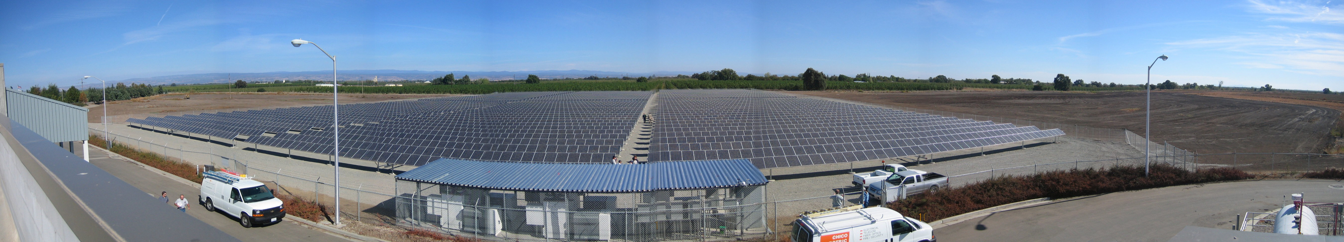
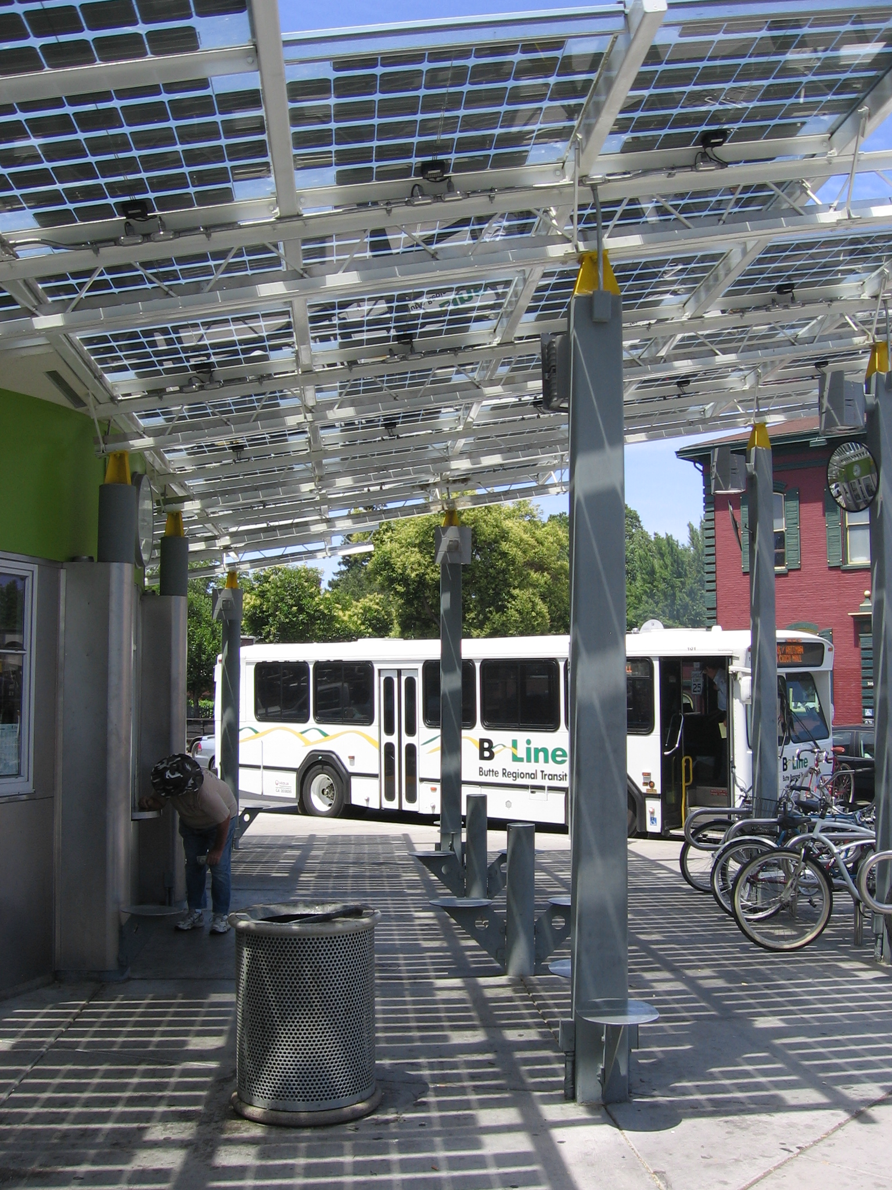

Slide 16
Examples of Some Phase 1 Actions
LED Street Lights
Lighting Upgrades
HVAC Control Retrofits
Chiller Retrofits
PC Power Management
Additional Hybrid Vehicles
Additional Acreage on Central Irrigation Controls
Weatherization/ Energy Audits- Pilots
RECO
New Bike Path- Hwy 99 Corridor
New Bike Path- 2nd Street
Franchise Waste Zones
Expanded Bus Routes
Household, School Outreach
Business Climate Partnership
Workshops
Website
Landfill Gas Capture
Additional City Composting

Slide 17
Implementation Monitoring
Key to implementation success will be continual monitoring of:
  Local Emissions Levels
  External Impacts
  Action Implementation Success
  Best Practices and New Technology
  Grant/Funding Availability
  Changes in Grid Mix and in Input Price Levels

Slide 18
Phase II Amendment Process
At the end of Phase I conduct a second GHG inventory.
Review Success of Phase I Actions
Review Success of External Actions
Phase II Actions Will be Selected Based on:
  Additional GHG emissions reductions needed
  Cost-Benefit Analysis
  Available Funding
CAP Amendment Approved by Council through Public Review Process

Slide 19
Climate Action Plan Timeline
March-April 2012: Public Comment Period of Draft CAP (STF meetings in March and April)
April-June 2012: Environmental Review
April-June 2012: Preparation of Final CAP
July-August 2012: Release of Final CAP
September 2012: Council Approval

Slide 20
Contact Information
Linda Herman, Administrative Manager
City of Chico General Services Department
Phone: 530-896-7241
Email: Lherman@ci.chico.ca.us
Fletcher Alexander, Analyst
Institute for Sustainable Development
Phone: 530-898-3332
Email: falexander@csu.edu
Notes:
20

